Slide 1
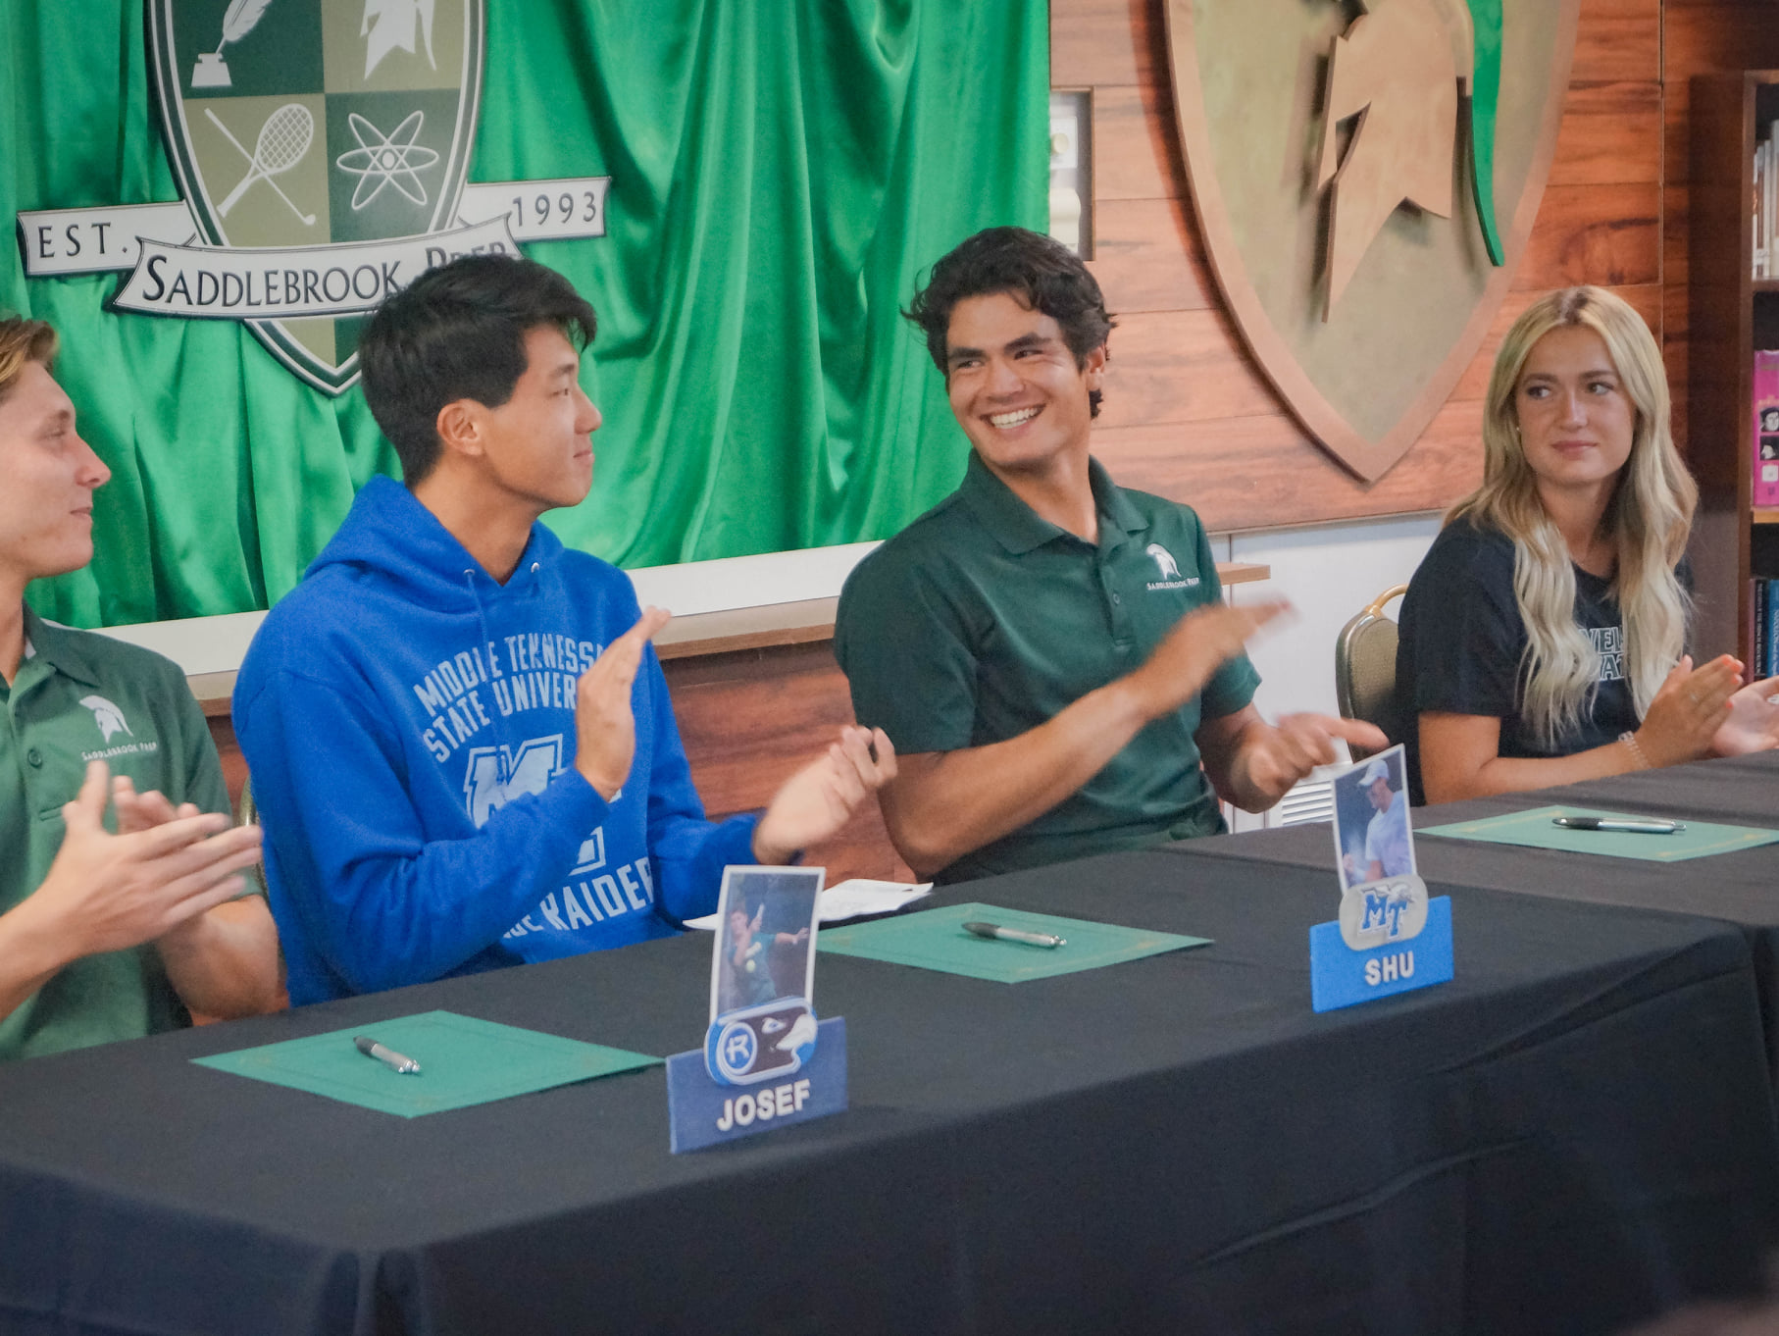
College
Recruiting
SADDLEBROOK PREP

Slide 2
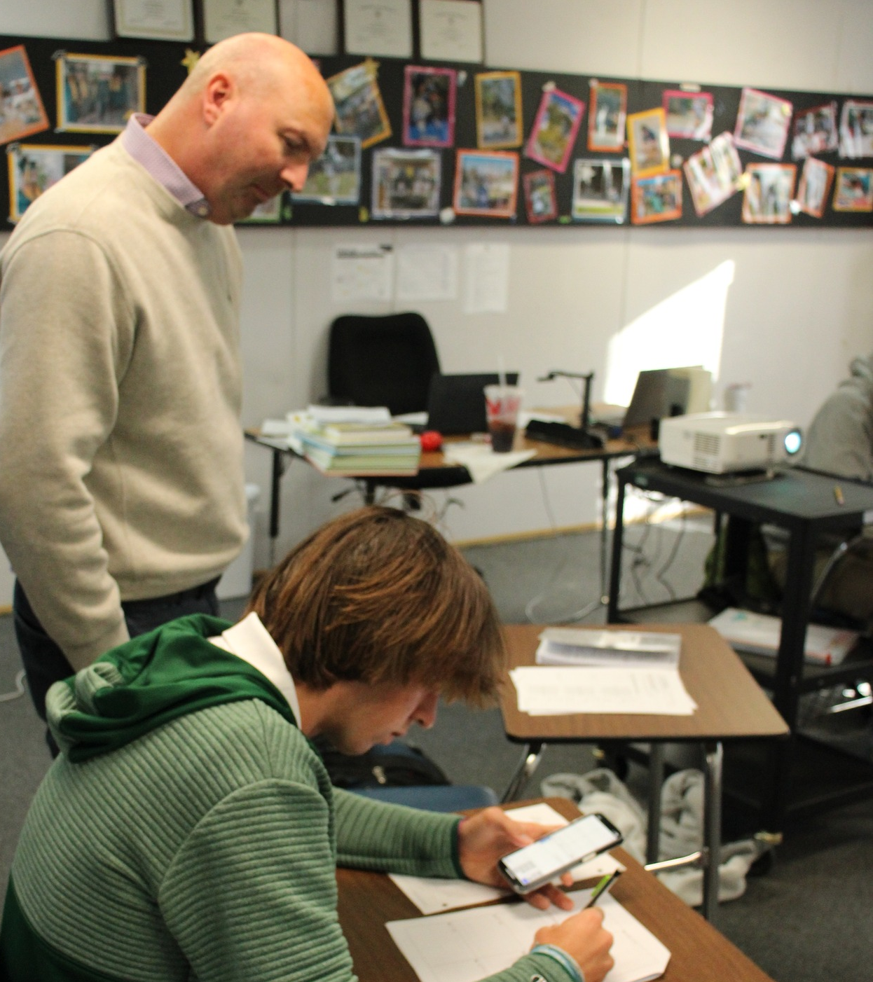
Your Mindset
Focus on learning and acquiring knowledge and skills
If learning is taking place, then grades will follow
Take an active interest in what your student is learning in school and engage them in conversation
What perspective or experiences can you add?
Don’t focus on getting into the best school, focus on getting into and attending the school that is right for you
Location, academic programs, team atmosphere/coach, price and availability of scholarships
Keep an open mind about NAIA schools and JUCOs

Slide 3
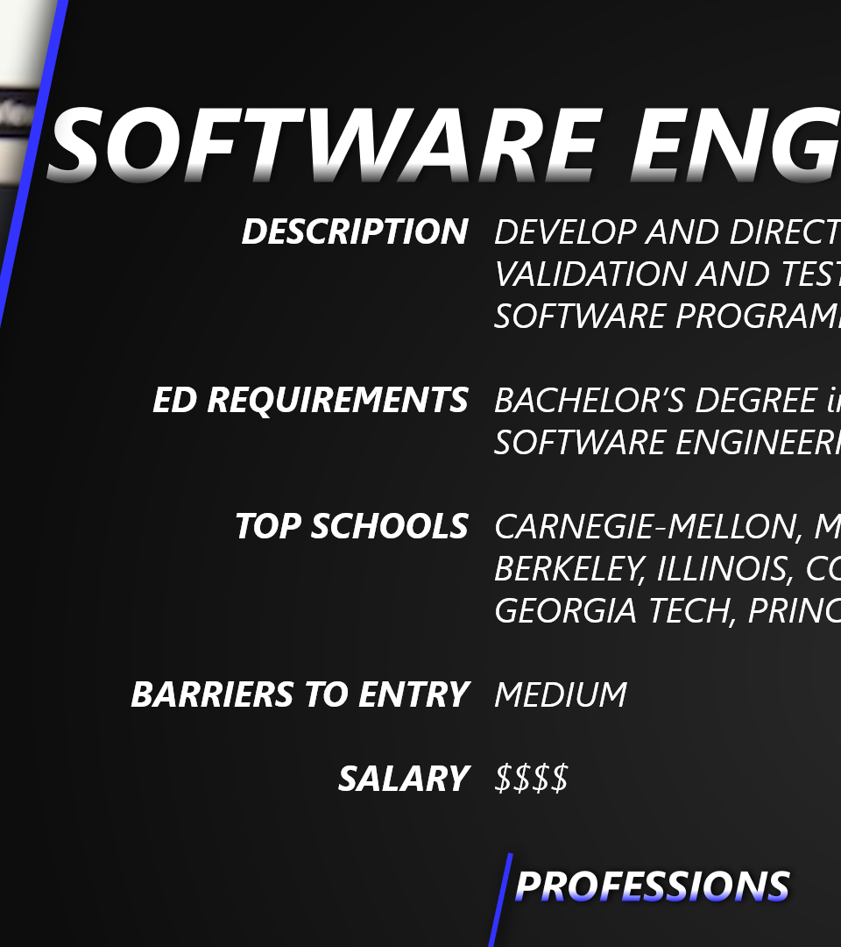
The Process – Work Backwards
Develop some sense of a professional track
Determine what level of education, licenses, and certificates are needed for those professions
Find colleges and universities that offer those programs and are in line with athletic ability
Determine the types of grades, classes, and other requirements needed to gain admission to those schools
Set realistic goals and work towards them

Slide 4
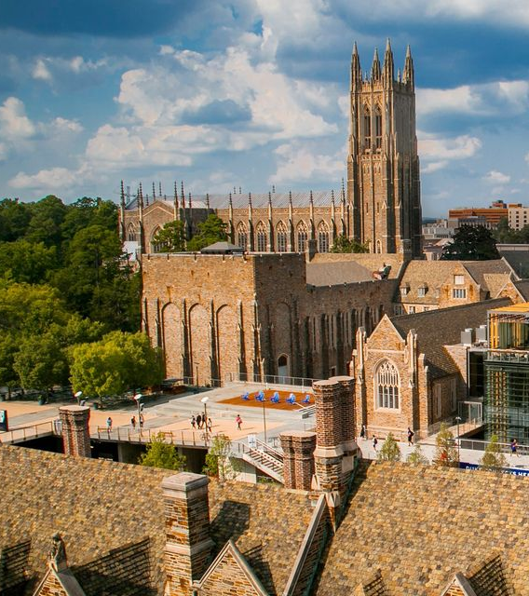
Colleges and Universities
College – a school that offers a specific set of specialized classes
College of Journalism, College of Engineering, College of Business
University – a mix of colleges located on one campus or organized under a single administration
University of South Florida, University of Tampa
Liberal Arts College – a post-secondary school that only offers bachelors degrees in topics related to liberal arts and sciences
English, History, Economics, Mathematics, Biology, etc.

Slide 5
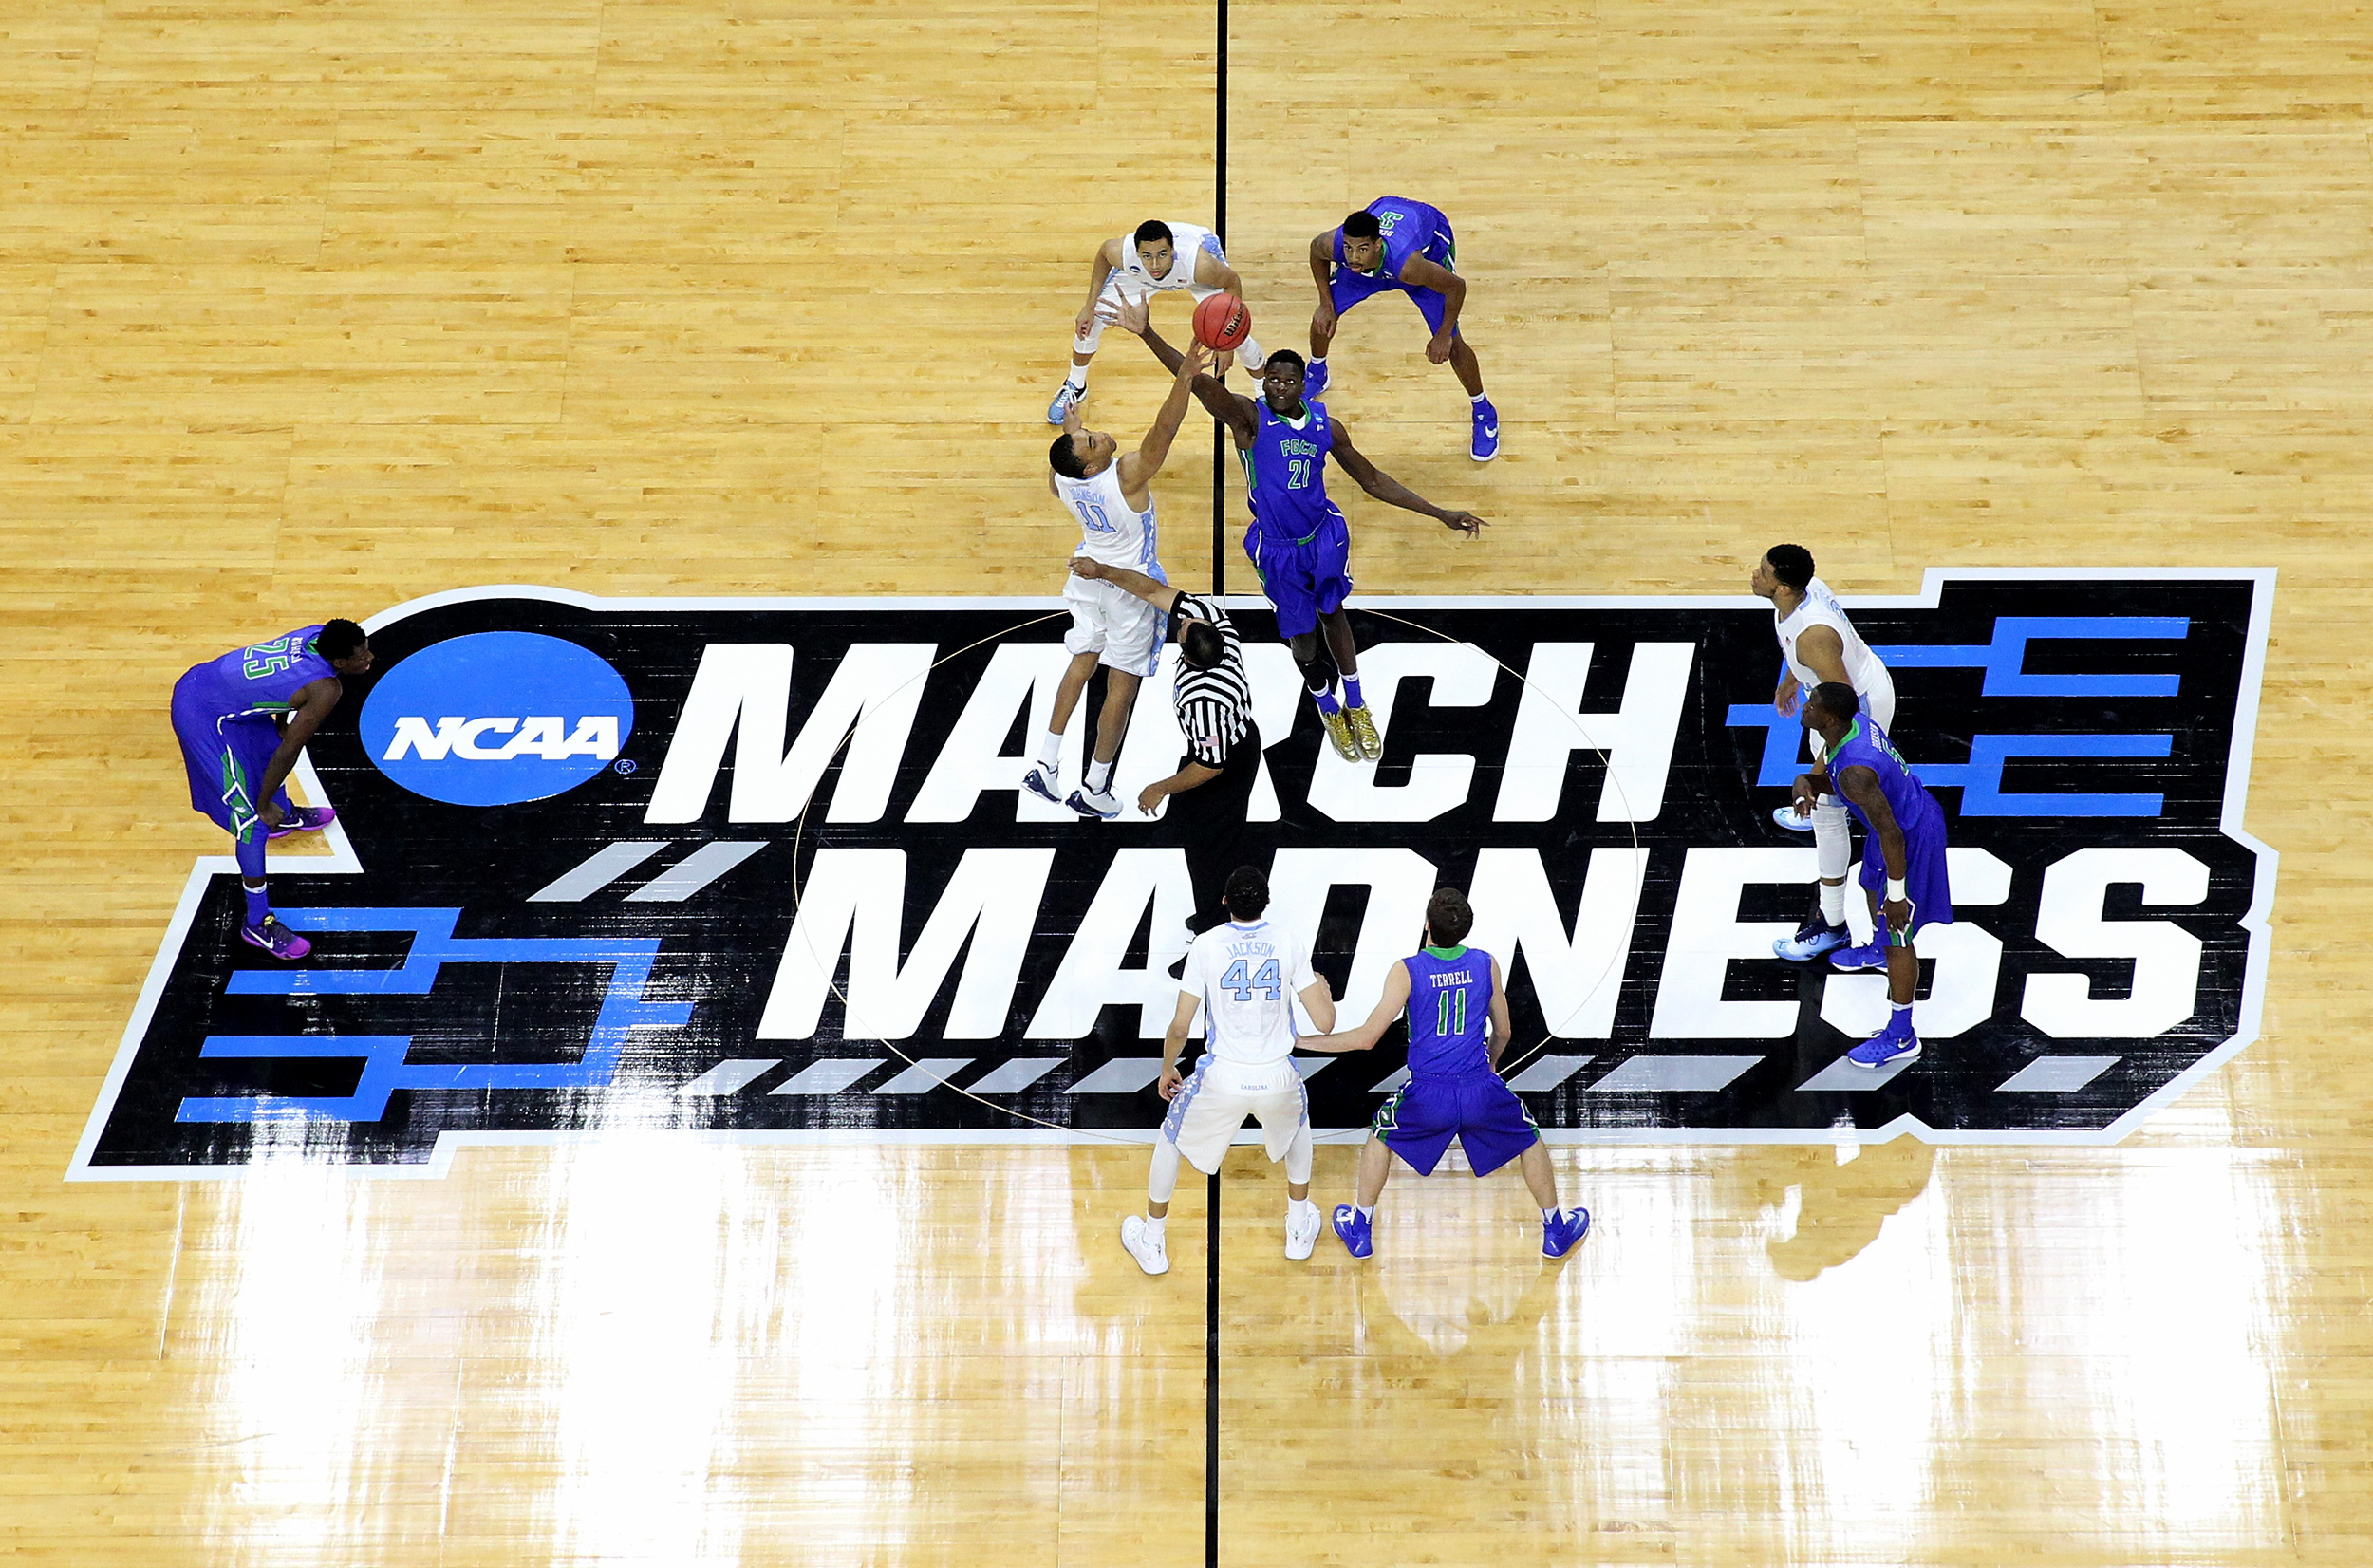
The NCAA
Legislates and enforces amateurism rules
Registration with the NCAA Initial Eligibility Center required for all levels of competition
Five years to compete four/Redshirting
Determines scholarship limits for Division I and II
Scholarship players (partial and full)
Preferred Walk-Ons
Walk-Ons
Runs end-of-season tournaments

Slide 6
US Sanctioning Organizations
Organization | Division | Conferences | Types of Schools | Scholarships/Team
NCAA | Division I | High-Majors (Power 5) Mid-Majors (Group of 5) Low-Majors (FCS) | Mostly Research and Doctoral Conferring Universities | Golf Men's: 4.5 | Women's: 6 Tennis Men's: 4.5 | Women's: 8
 | Division II | Similar Schools by Region | Some Doctoral, Some Universities, and Some Liberal Arts | Golf Men's: 3.6 | Women's: 5.4 Tennis Men's: 4.5 | Women's: 6
 | Division III | Similar Schools by Region | Mostly Liberal Arts and Some Universities | No Athletic Scholarships (only academic money given)
NAIA | None | Similar Schools by Region | Smaller Schools, Colleges, and Universities | Golf Men's: 5 | Women's: 5 Tennis Men's: 5 | Women's: 5
NCCAA | Division I | Regional | Bible Colleges and Seminaries | Golf Men’s: 5 | Women’s: 5 Tennis Men’s: 5 | Women’s: 5
 | Division II | Regional | Bible Colleges and Seminaries | Golf Men’s: 5 | Women’s: 5 Tennis Men’s: 5 | Women’s: 5
NJCAA | None | By State/Regional | 2-Year Colleges and a Few 4-Year Programs | Golf Men's: 8 | Women's: 8 Tennis Men's: 9 | Women's: 9
NCAA Interactive Map
NAIA Interactive Map
NJCAA Map
NCCAA Member Listing

Slide 7
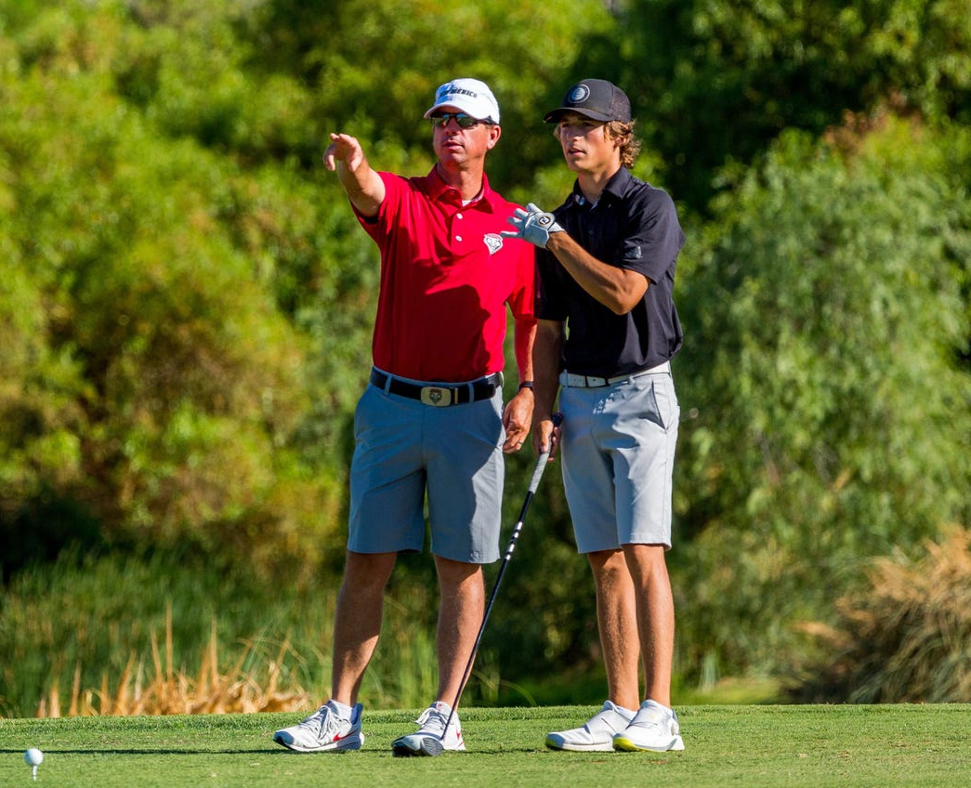
Recruiting
Recruiting is a student-led process
Self-promotion through résumés, emails, social media, cold calls, and in-person contacts
Developing relationships with coaches at programs of interest
College advisor, administration, teachers, and parents act as a support system
Provide advice, proofread emails, help them locate resources, etc.
Become knowledgeable about the process
College Counseling Site
NCSA Videos

Slide 8
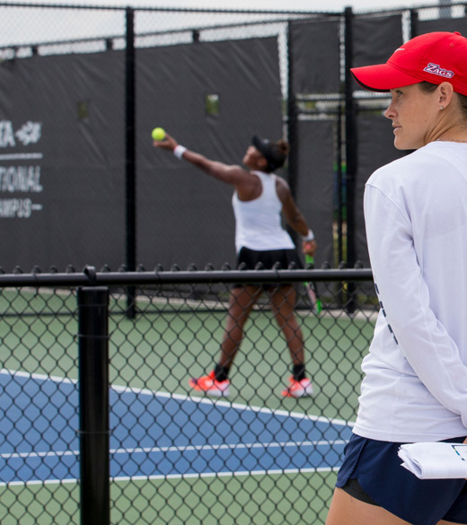
Recruiting
Accounts needed for this process
  NCAA Initial Eligibility Center
  Common App – college applications for 1,000+ schools
Tennis
  UTR – tracks all eligible tournaments and matches
Golf
  HJGT – personal player page with records by year
  Junior Golf Scoreboard

Slide 9

Other Resources
USTA, Tennis Recruiting, NCSA Men’s Tennis, NCSA Women’s Tennis, US Sports Camps, ITA Collegiate Tennis Rankings
Junior Golf Scoreboard, NCSA Men’s Golf, NCSA Women’s Golf, Junior Golf Hub, Golfstat Collegiate Golf Rankings, CollegeGolf.com

Slide 10
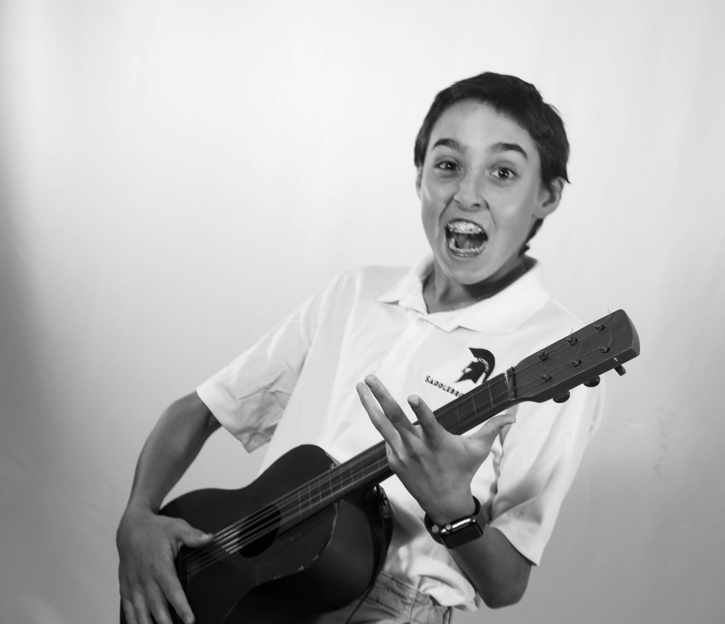
Middle School
This time is going to set the foundation for everything that’s done in high school
Find topics for leisure reading – avoid social media as much as possible and replace it with well-written materials
Learn to write – pay attention to grammar and learn how words are constructed
Play tournaments and learn to adjust to tournament settings
Take the PSAT 8/9 to get a sense of what standardized tests are all about
Remember that high school classes count towards the high school GPA (Algebra I)

Slide 11
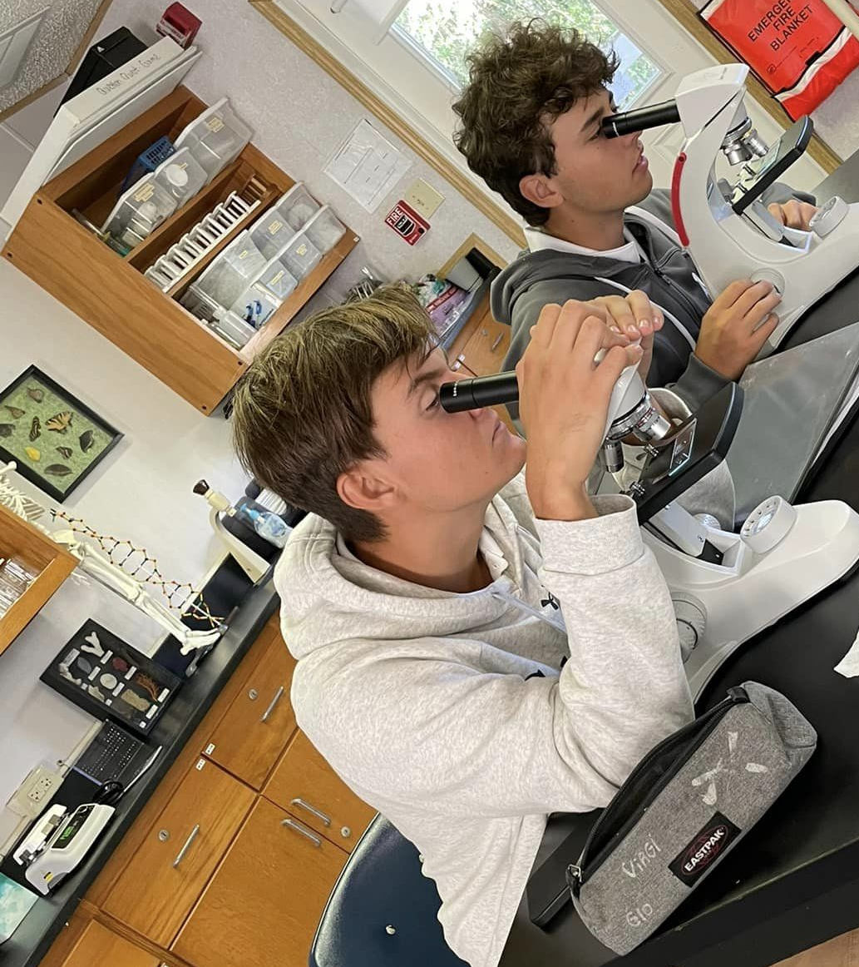
High School Classes
16 Core Classes required by the NCAA and most colleges
English 9-12 and AP courses
Algebra I through Calculus
3-4 Sciences
World History, US History, American Government, and Economics
Foreign Languages
Rest of the schedule is filled out by electives and grades from sport

Slide 12

Freshman Year

Slide 13
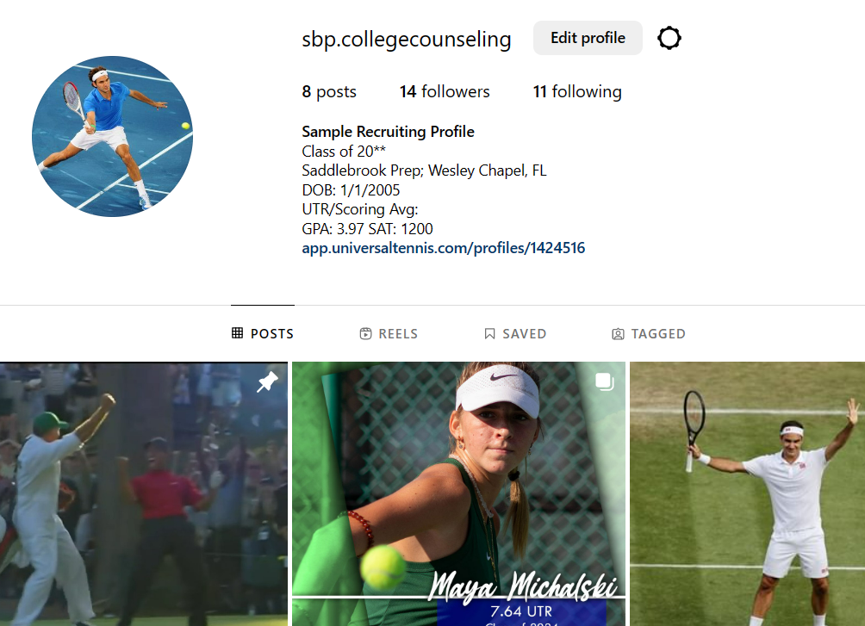
August
Download the NCAA’s Guide for the College Bound Student Athlete
Pay particular attention to p. 13-14 which provide a checklist of actions and the NCAA’s account types
Set up a sport-specific social media account (preferably Twitter)
J
N
D
F
M
A
M
Freshman Year

Slide 14
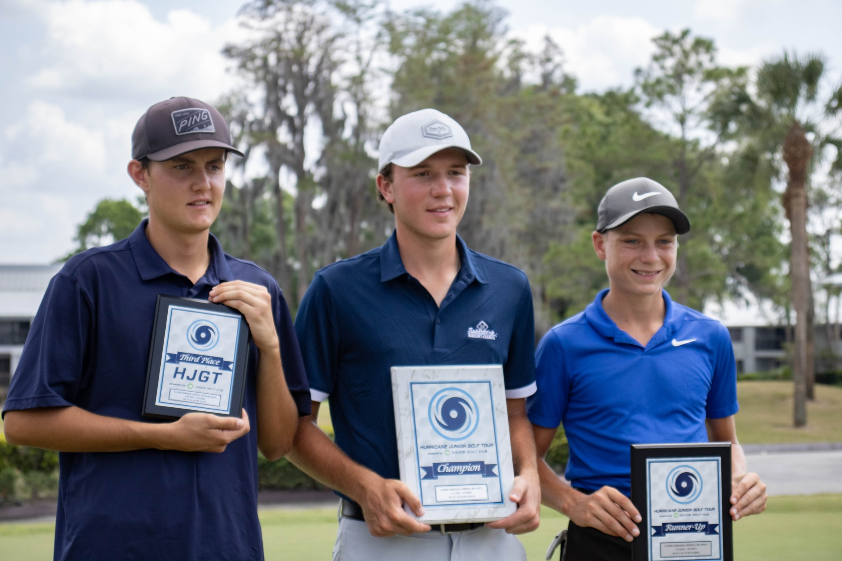
August/September
Grades count towards your high school GPA
Colleges will look at six semesters worth of grades (Fall of 9th grade through spring of 12th grade)
Keep a list of your last ten tournaments played and their results
Attend résumé writing seminar
J
N
D
F
M
A
M
Freshman Year

Slide 15

October
Take the PSAT 9
Start building a list of schools you’d like to attend
Tennis (Recommended): 30-50 schools
Golf (Recommended):
NCAA Initial Eligibility Center Discussion and Registration
J
N
D
F
M
A
M
Freshman Year

Slide 16
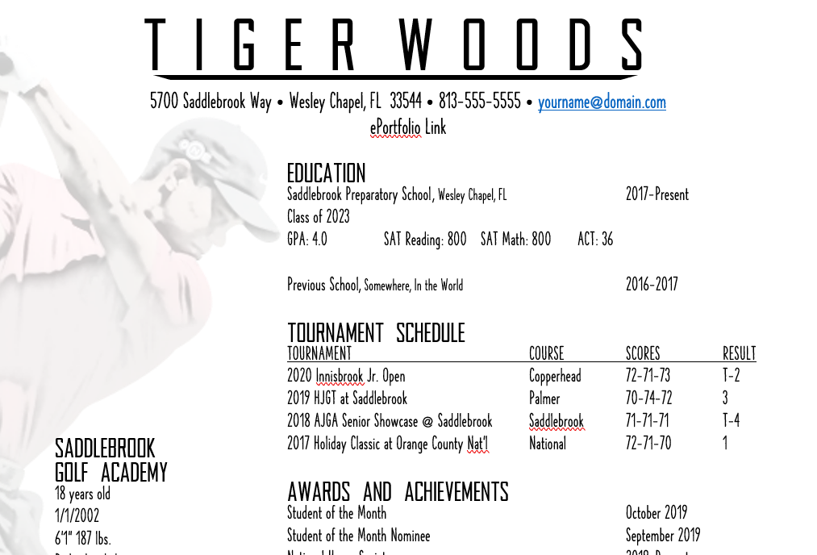
January/February
Have résumé built by the end of January (to be submitted for grading to the student’s English teacher)
Use any of the templates found on the Saddlebrook College Counseling website
Have a native English speaker or someone who is completely proficient in English proofread your résumé
Email your résumé to college coaches
J
N
D
F
M
A
M
Freshman Year

Slide 17

June
Update your résumé
Play tournaments
Work on any academic skills with which you struggled
READ!!!
J
N
D
F
M
A
M
Freshman Year

Slide 18
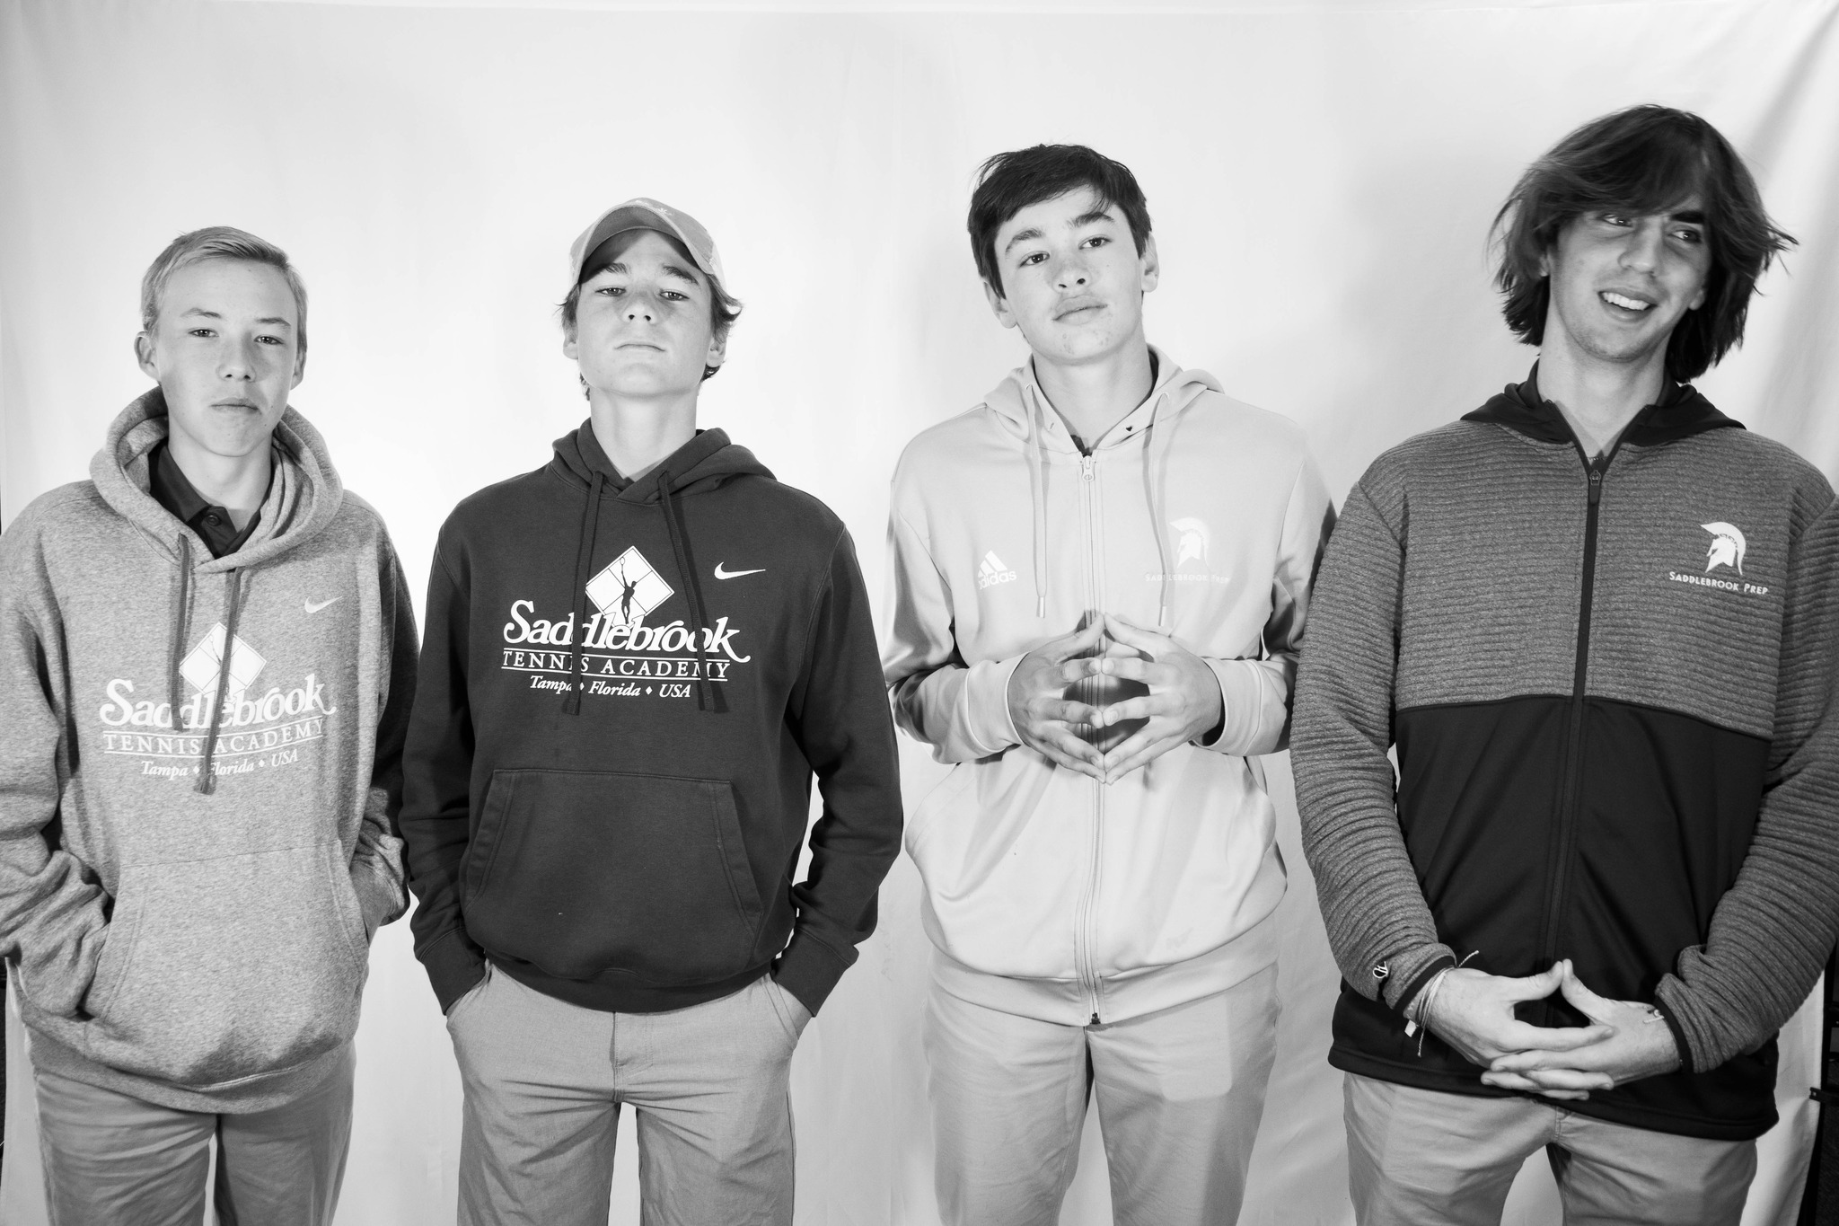
J
A
N
F
A
M
Sophomore Year

Slide 19

September
Complete registration with the NCAA
Continue posting to your social media accounts and tag coaches directly
Continue sending emails and résumés to college coaches
College Lists: 20-40 schools
Attend résumé writing seminar
J
A
N
F
A
M
Sophomore Year

Slide 20
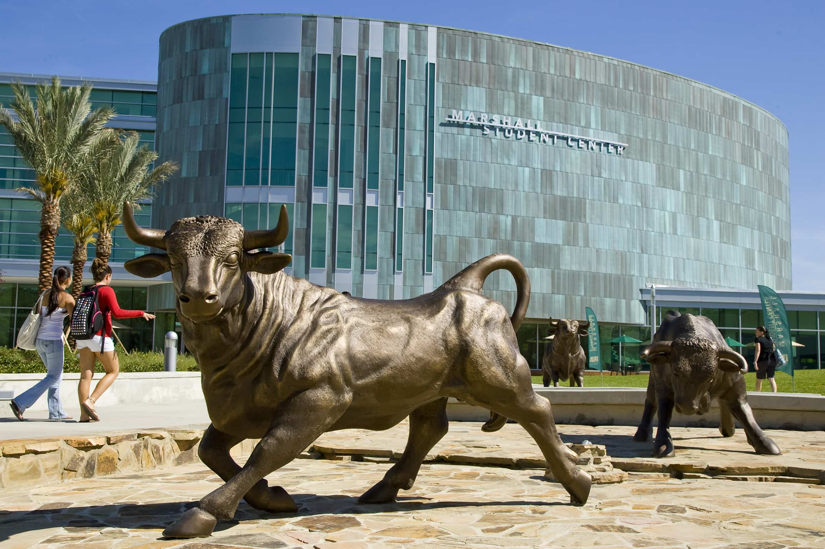
October
Take the PSAT 10
Attend the USF campus visit
Film recruiting video if your coach believes you’re ready
NCAA Initial Eligibility Center Discussion and Registration
J
A
N
F
A
M
Sophomore Year

Slide 21
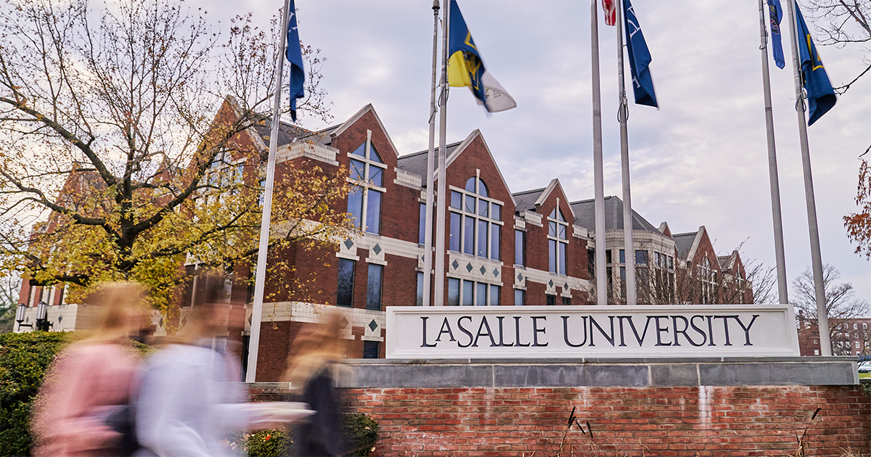
December
Visit a college or two that’s close to your home while you’re on winter break
J
A
N
F
A
M
Sophomore Year

Slide 22

January
Update your résumé
Register for the SAT if you are a golfer and/or you are enrolled in or completed Algebra II
J
A
N
F
A
M
Sophomore Year

Slide 23
March
Take the SAT
J
A
N
F
A
M
Sophomore Year

Slide 24
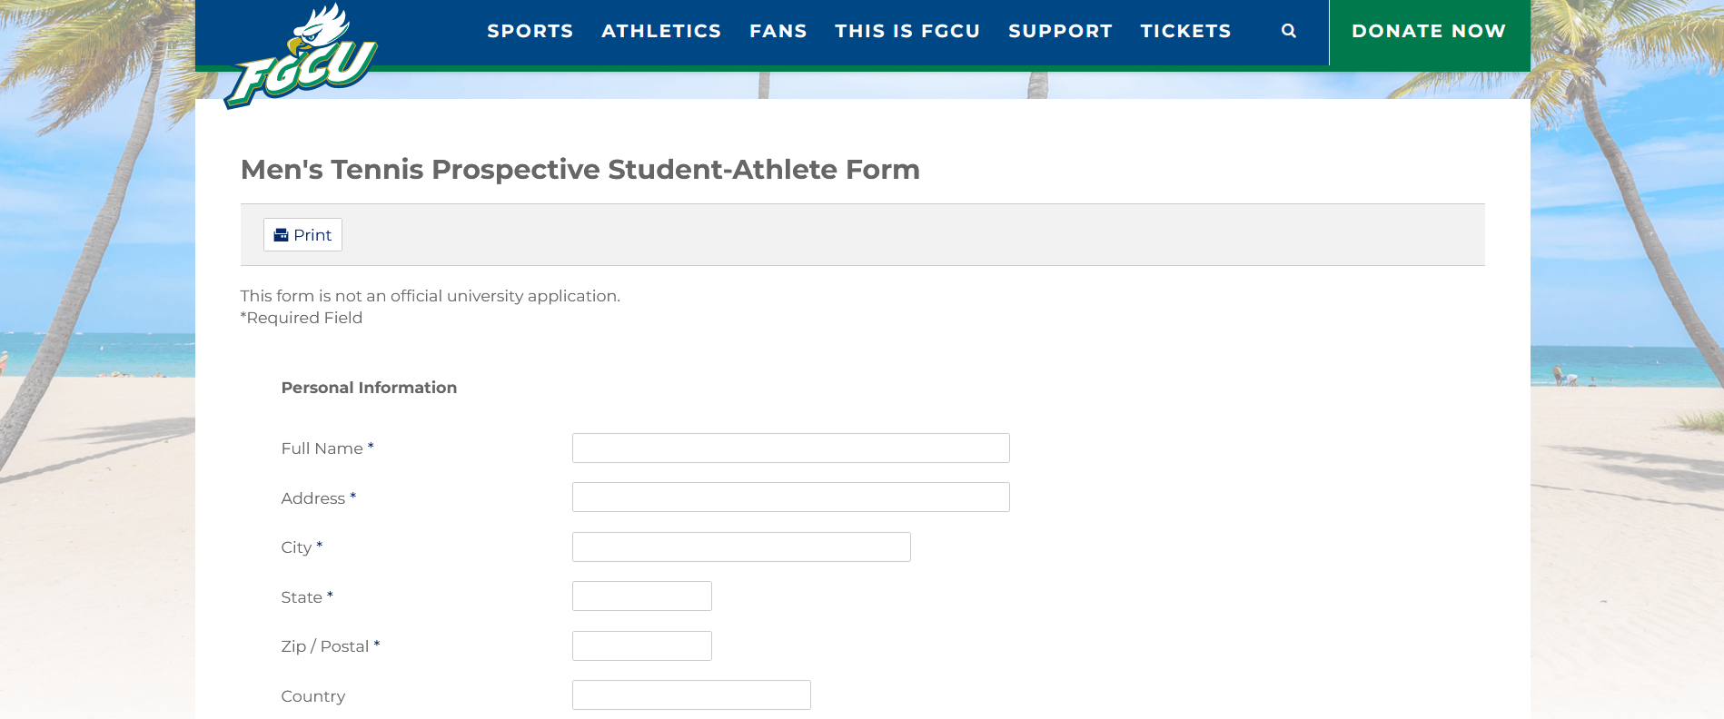
June
Fill out questionnaires on college athletics websites
Consider taking AP classes in your junior and senior years (especially if you’re looking at colleges with high admissions standards)
Take unofficial visits to college campuses
Coaches can respond to contacts beginning June 15
READ!!!
J
A
N
F
A
M
Sophomore Year

Slide 25

J
A
S
O
N
D
J
F
M
A
M
J
Junior Year

Slide 26

August/September
Begin taking unofficial visits starting August 1
Update recruiting video
Take SAT Prep if the class is offered
Attend résumé writing seminar if you have not created one
College Lists: 20-30 schools
J
A
S
O
N
D
J
F
M
A
M
J
Junior Year

Slide 27
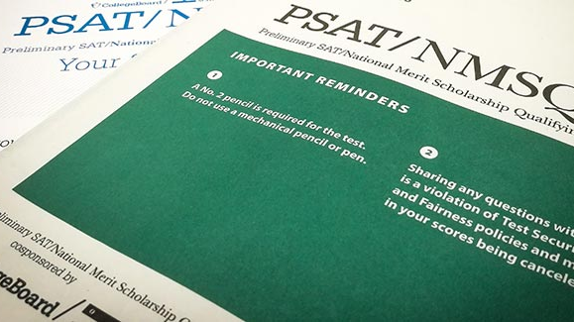
October
Take the PSAT/NMSQT
Attend the USF campus visit
J
A
S
O
N
D
J
F
M
A
M
J
Junior Year

Slide 28
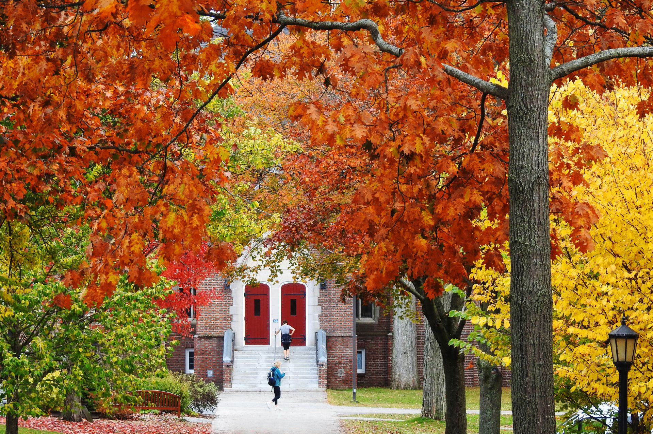
November and December
Take unofficial visits to colleges during Thanksgiving and winter breaks
J
A
S
O
N
D
J
F
M
A
M
J
Junior Year

Slide 29
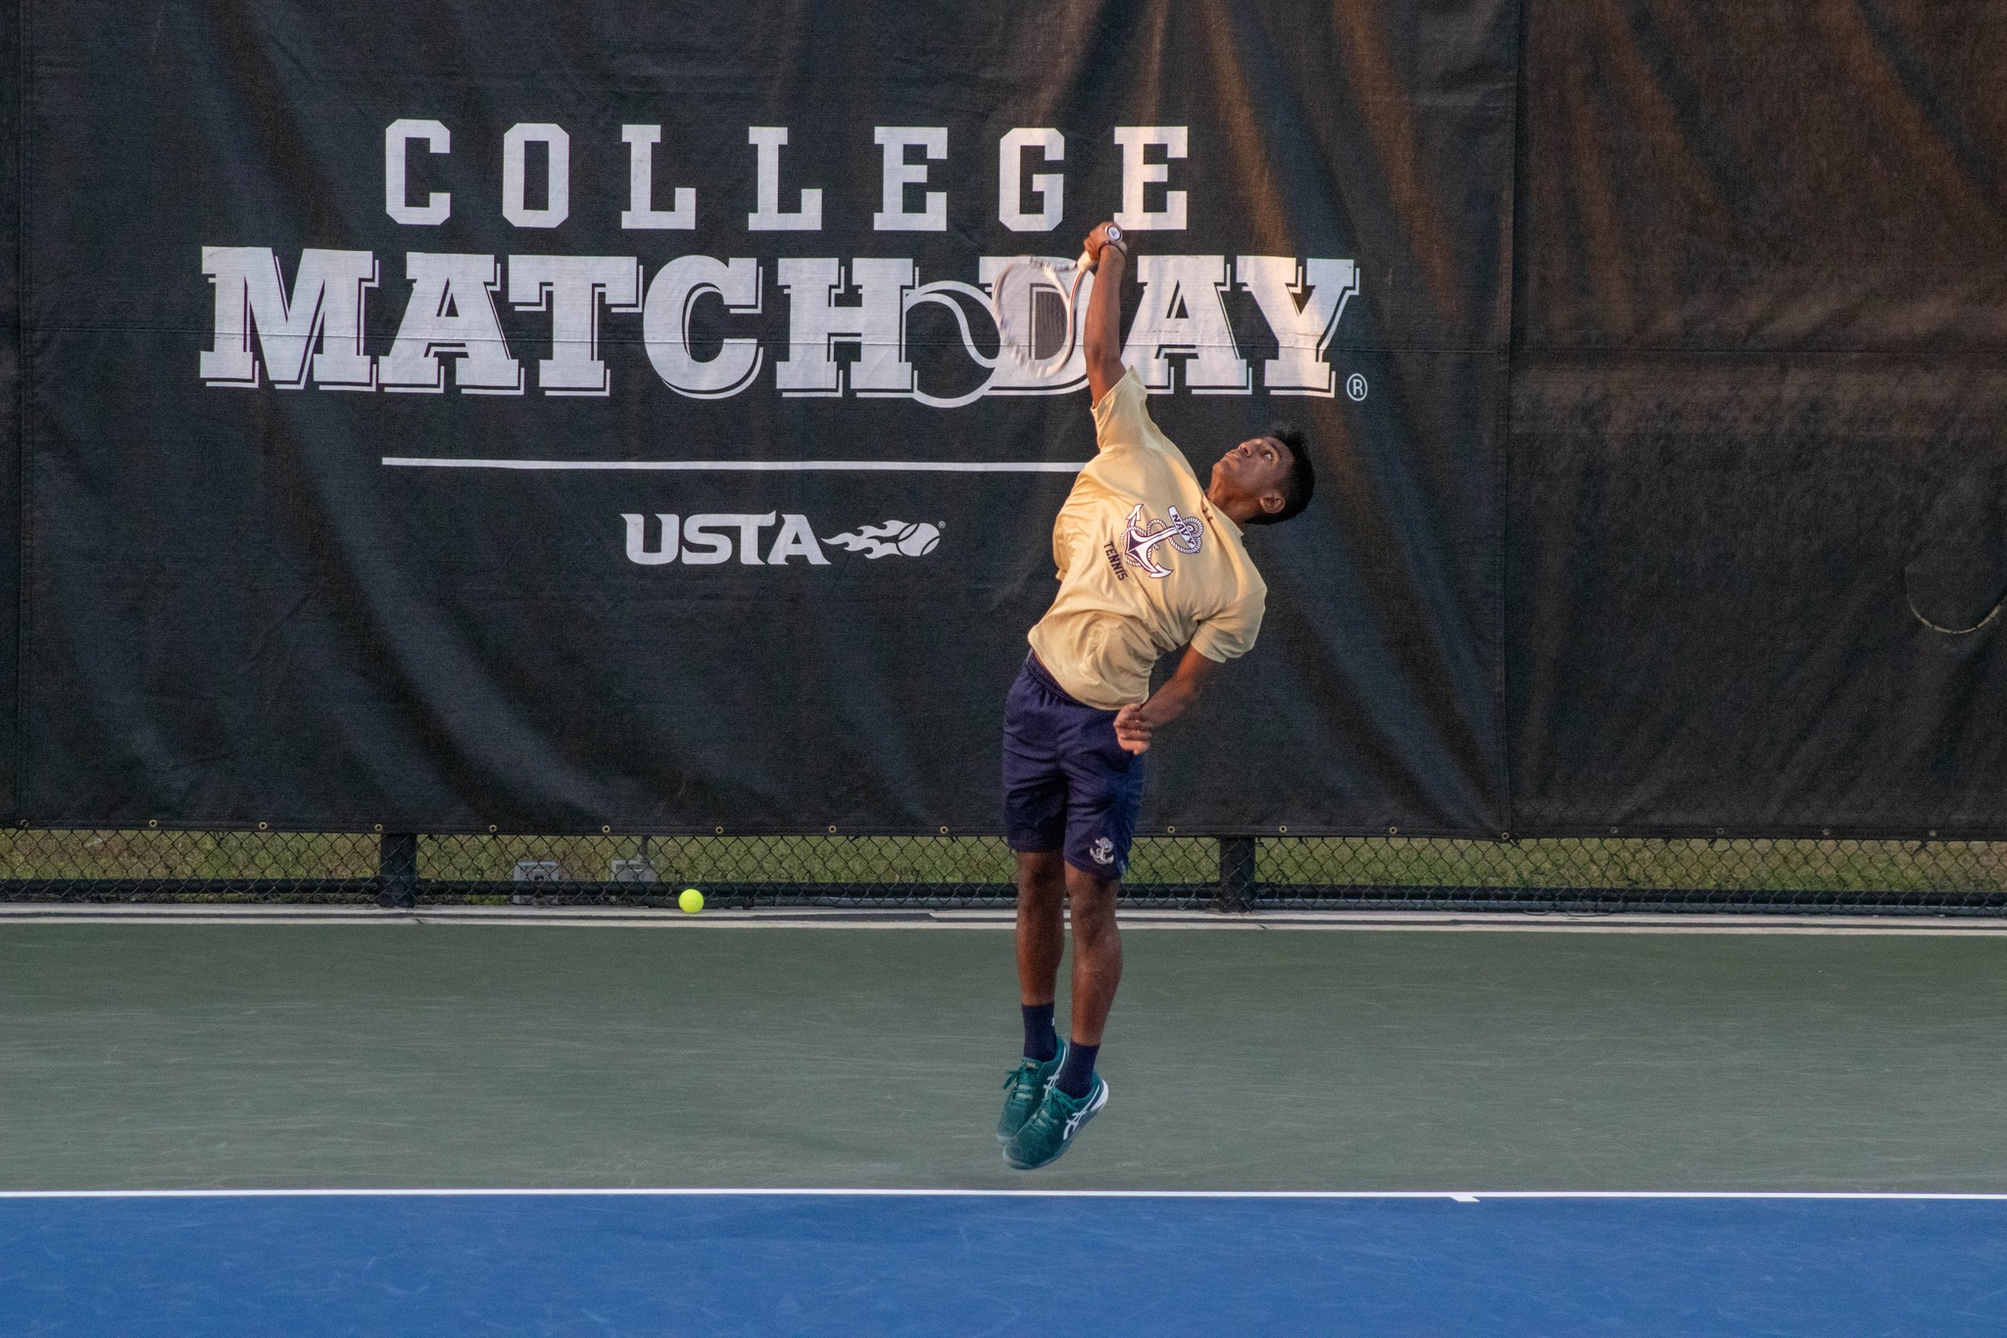
March
Take the SAT
Begin planning official visits if offered by coaches – students have two excused absences for college visits in their junior year
Go to spring break college tournaments or matches in Tampa Bay and Central Florida – speak directly with coaches
J
A
S
O
N
D
J
F
M
A
M
J
Junior Year

Slide 30
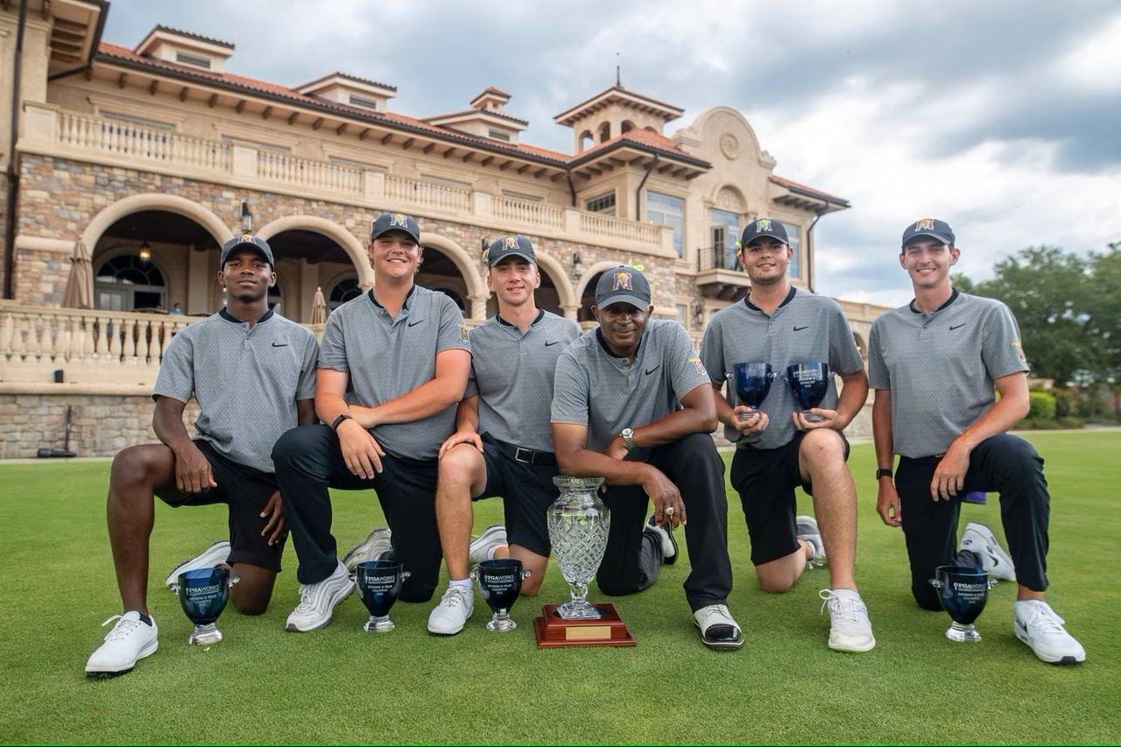
June
Update your résumé
Take unofficial visits to college campuses
READ!!!
J
A
S
O
N
D
J
F
M
A
M
J
Junior Year

Slide 31
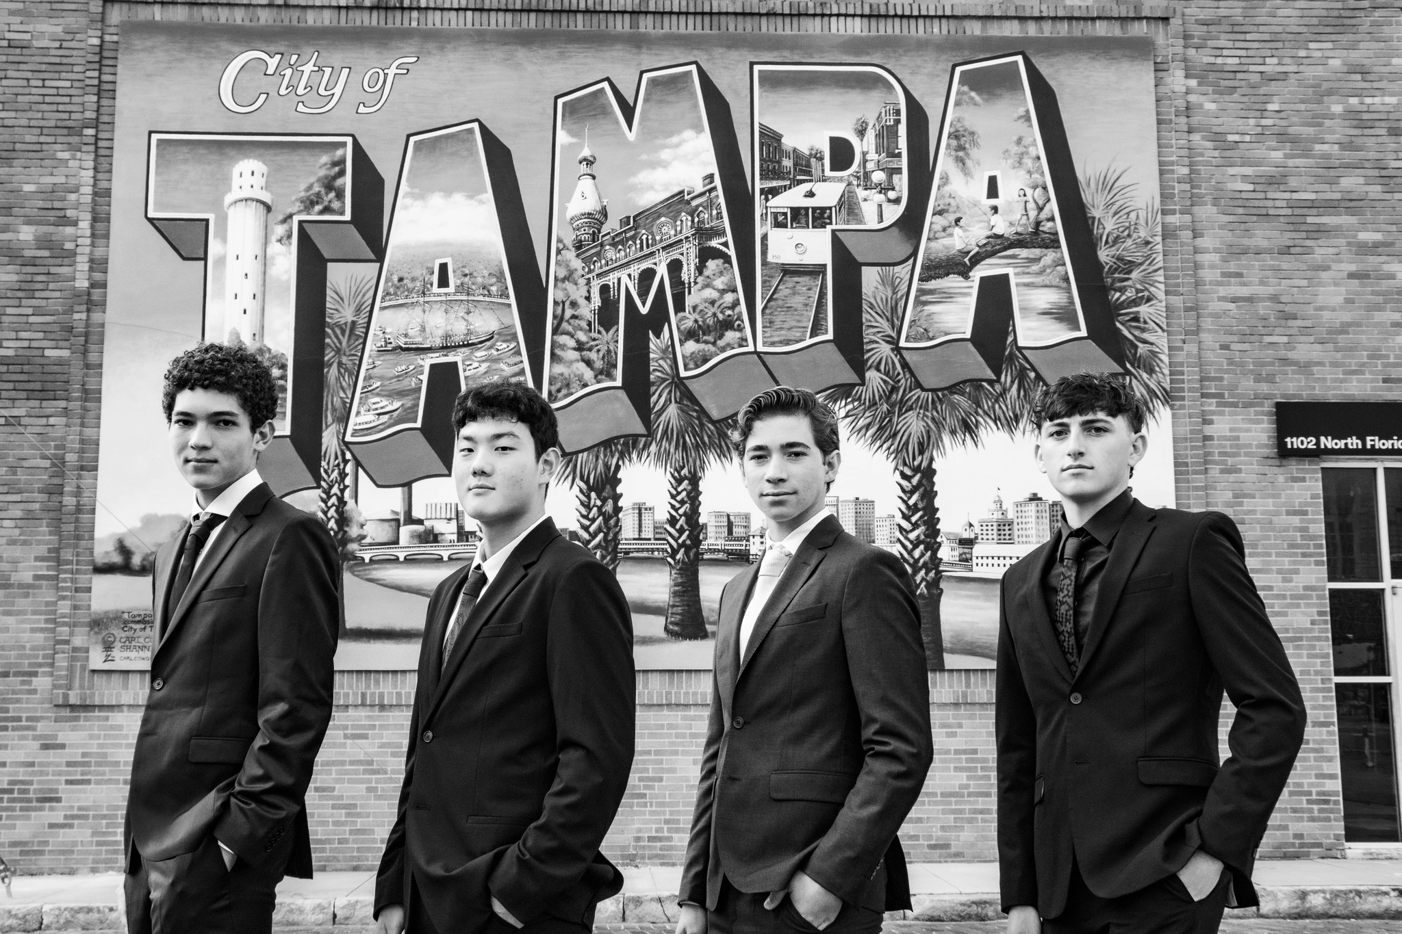
J
A
S
O
N
D
J
F
M
A
M
J
Senior Year

Slide 32
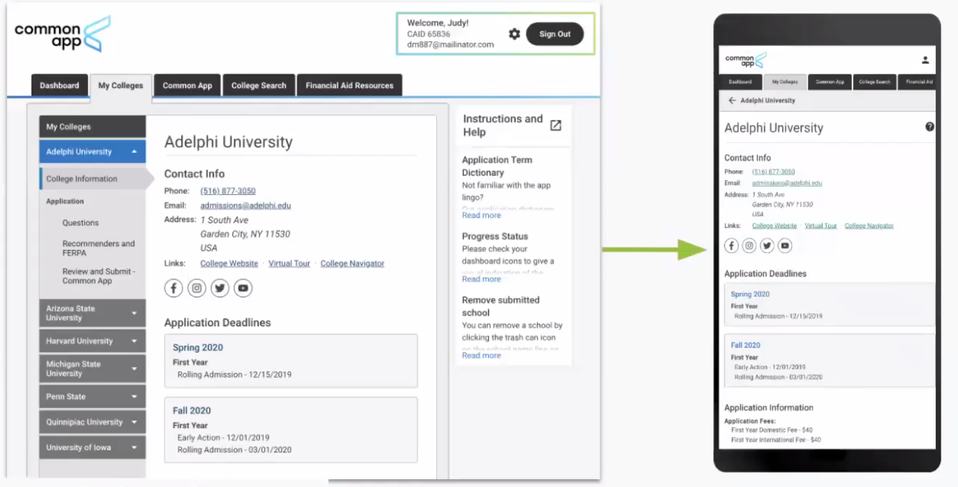
August
Register for the SAT or ACT if you need to take either of them again – register for the earliest possible date
Create a Common App account for college applications
Counselor: Ms. Garrett
Advisor: Mr. Rosenke
Recommenders: choose two teachers and ask them if they will write letters of recommendation
J
A
S
O
N
D
J
F
M
A
M
J
Senior Year

Slide 33
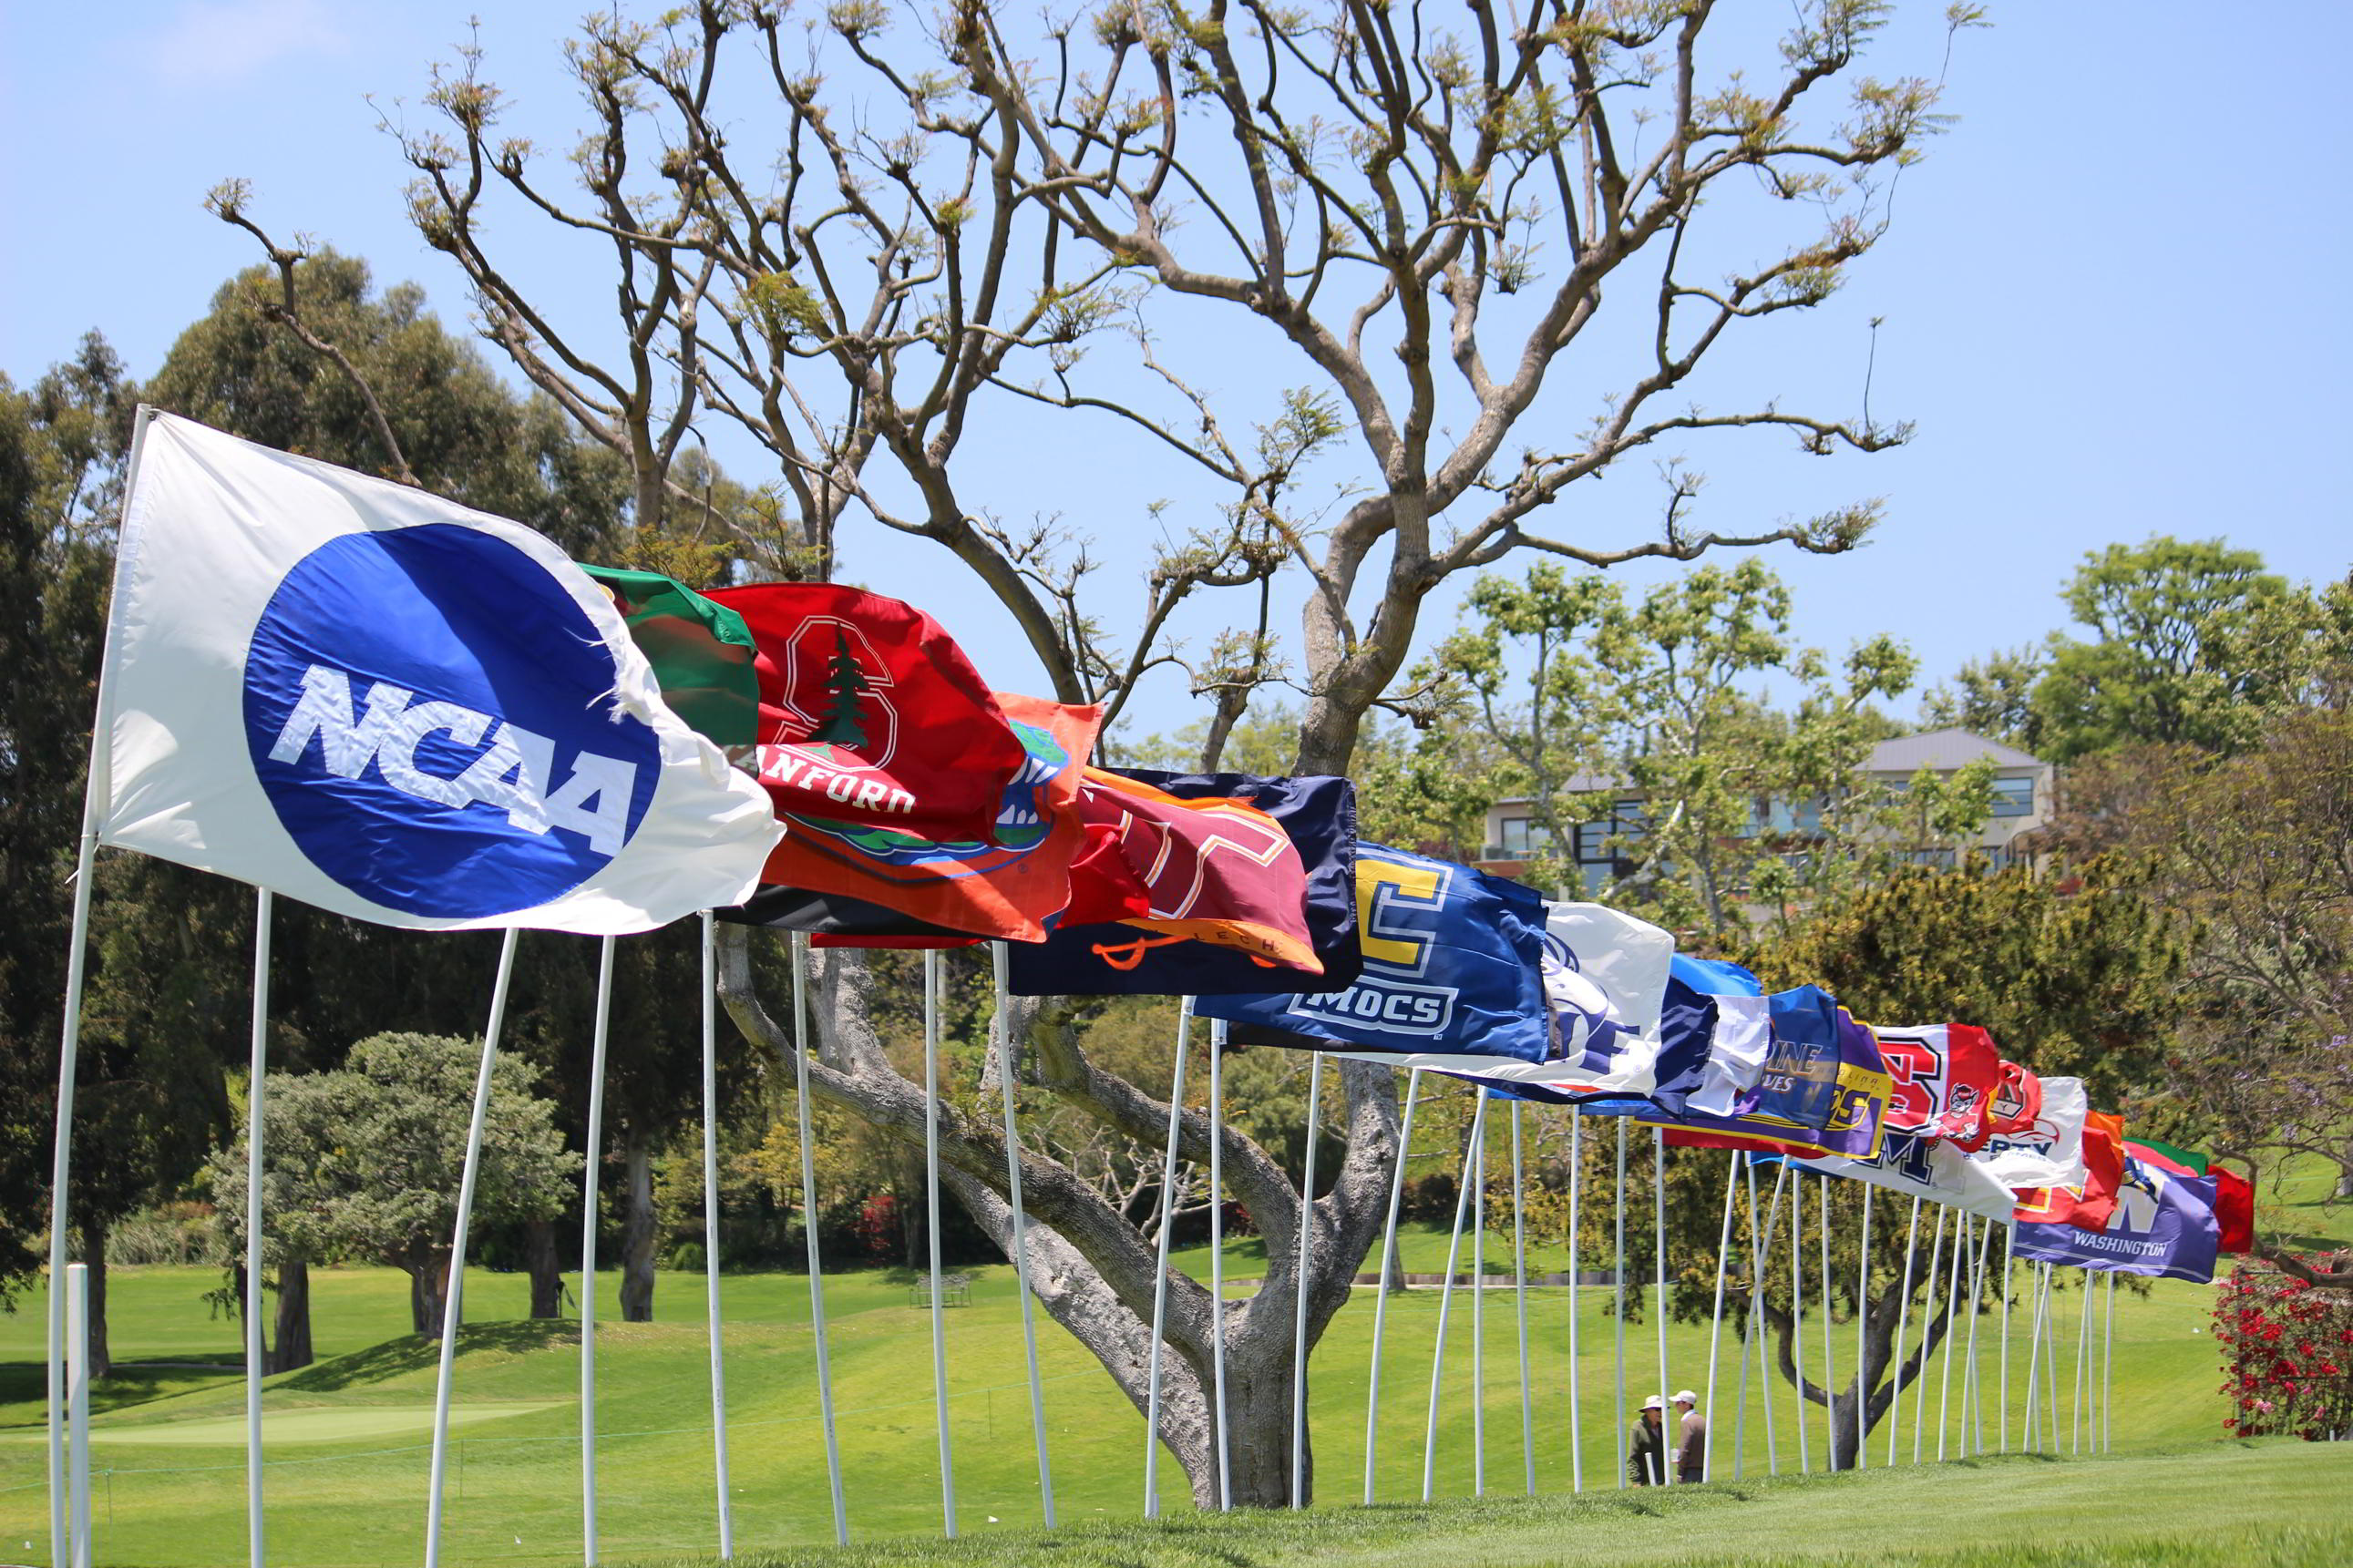
September
Take any remaining official visits
College Lists: 5-10 schools
J
A
S
O
N
D
J
F
M
A
M
J
Senior Year

Slide 34
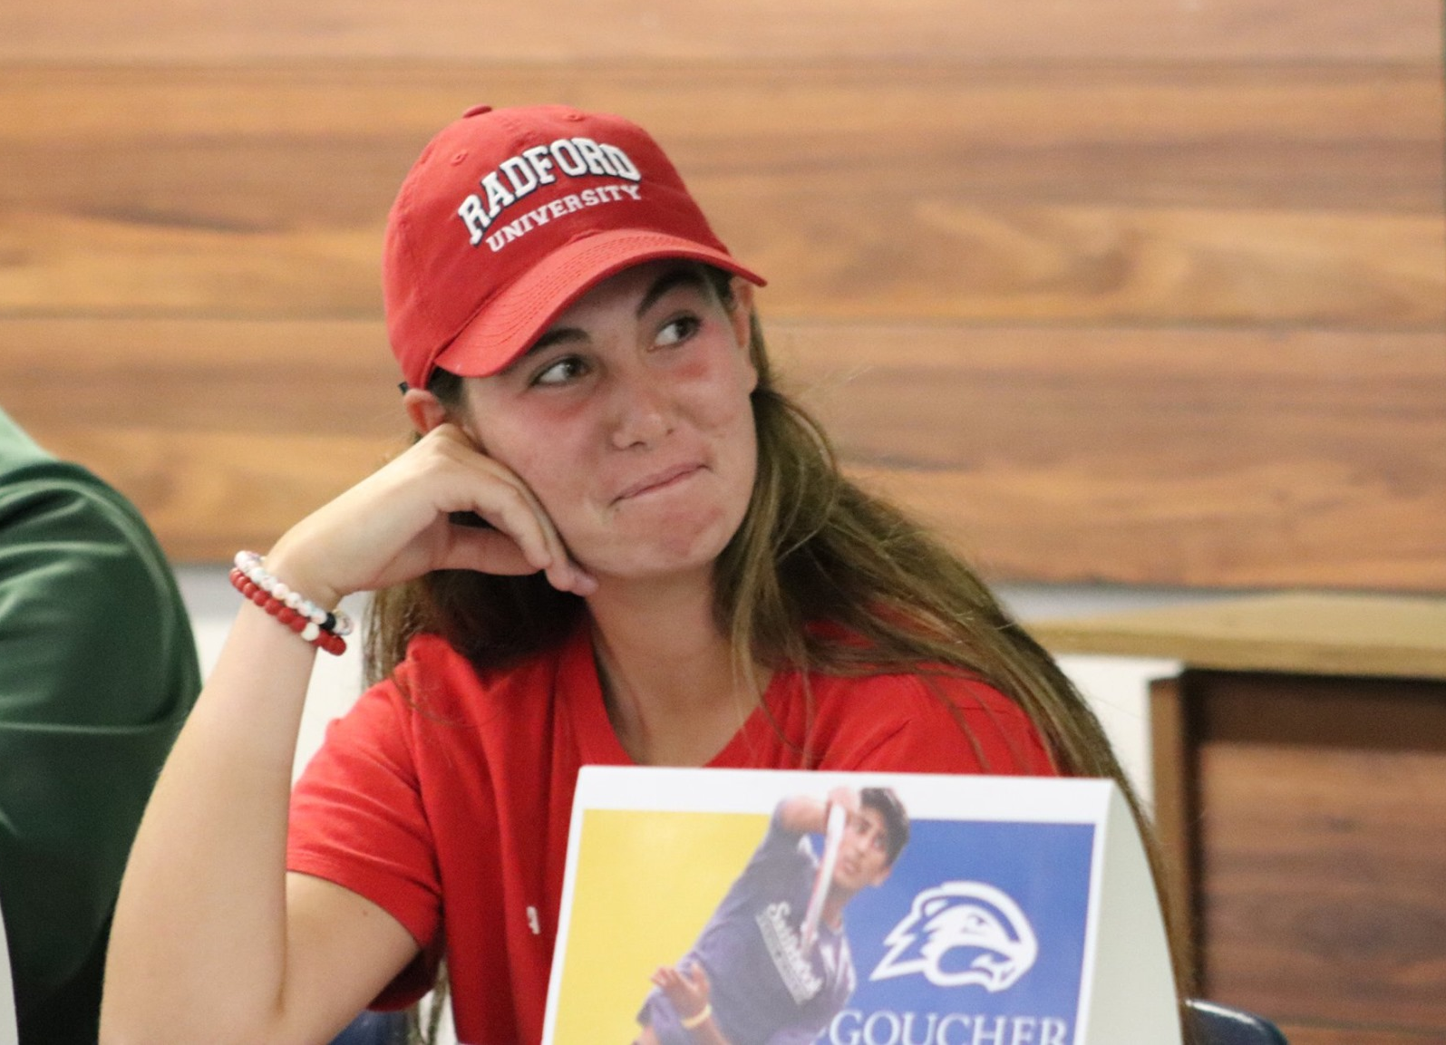
November
Sign your National Letter of Intent – may be signed at any point during or after National Signing Day
J
A
S
O
N
D
J
F
M
A
M
J
Senior Year

Slide 35

April
Complete the final amateurism certification with the NCAA
Attend the College-Bound Seniors Seminar
Meet all deadlines for academic and housing deposits, as well as immunizations
Grad Bash at Universal Orlando
Join social media groups for your college graduating class
J
A
S
O
N
D
J
F
M
A
M
J
Senior Year

Slide 36

June
GRADUATION!!!
Request final transcripts be sent to your college and the NCAA
Finish Florida Bright Futures paperwork if eligible
Confirm all paperwork is complete
J
A
S
O
N
D
J
F
M
A
M
J
Senior Year

Slide 37
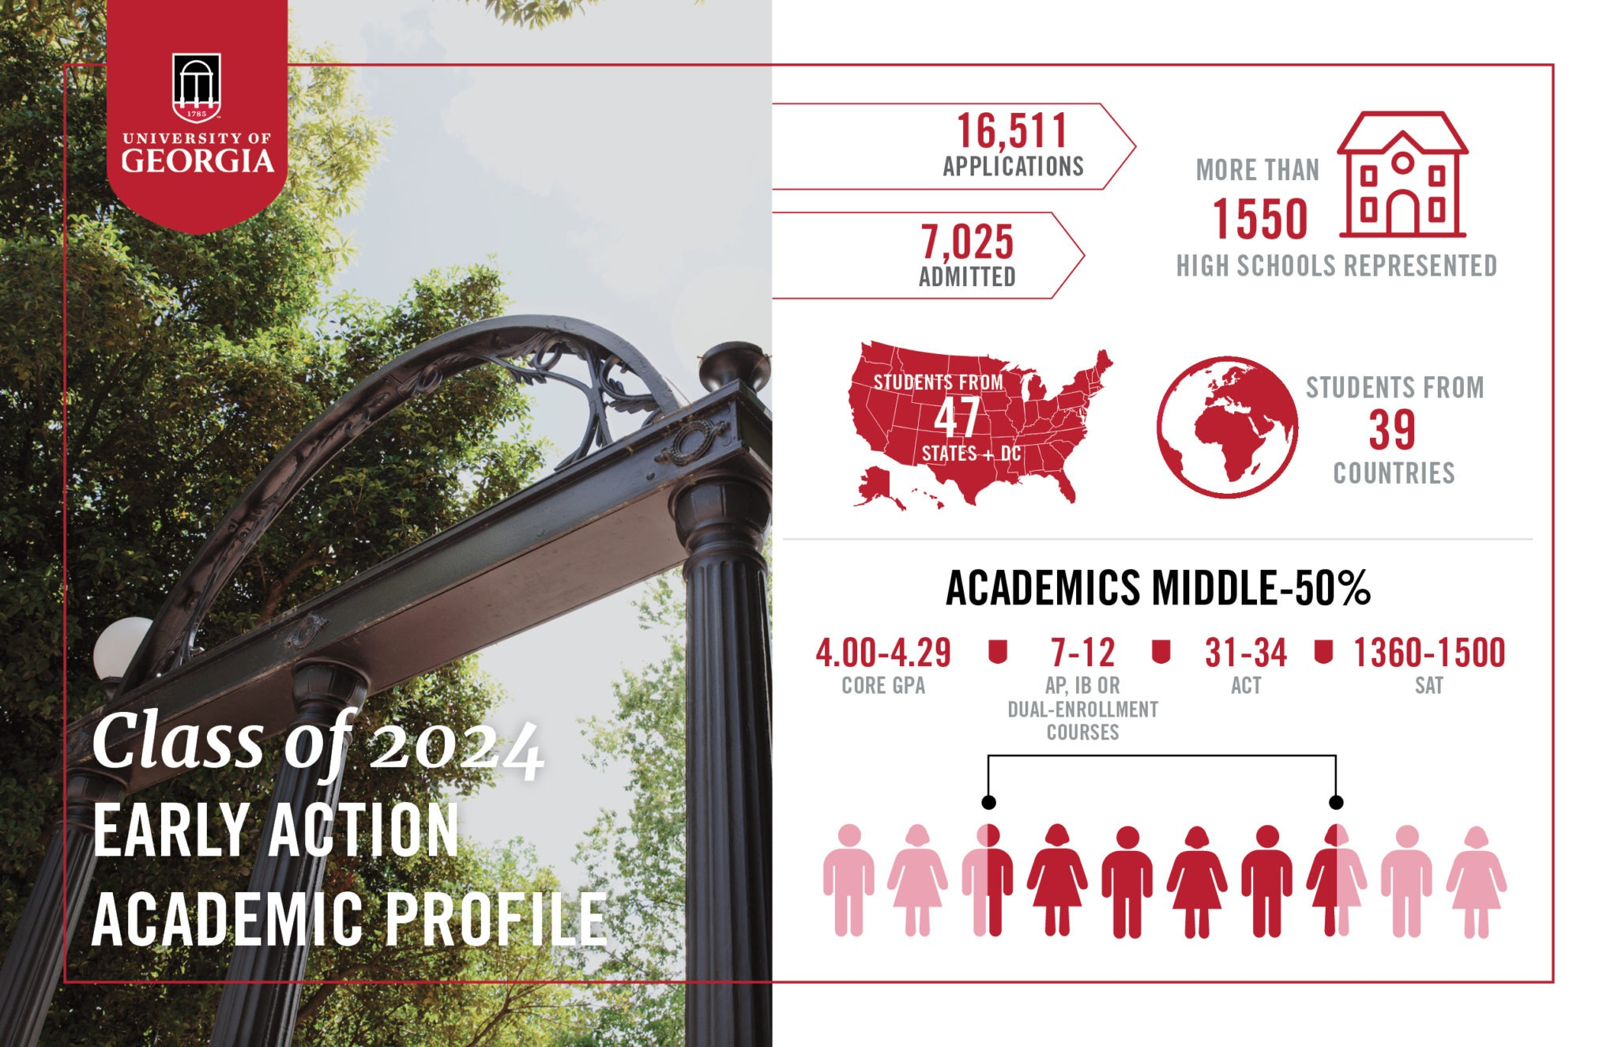
College Lists
Dream School – the school that if you were accepted you would go to because it’s always been the school you’ve followed or you may have family connections to it
Stretch School – a school whose GPA, entrance exam requirements, and/or UTRs/scoring averages are better than your current numbers
Realistic School – a school whose GPA, exam scores, and athletics are in line with yours
Safety School – a school whose GPA, exam scores, and athletics are less than your current numbers
Middle 50% - GPA and scores of the middle quartiles of a freshman class

Slide 38
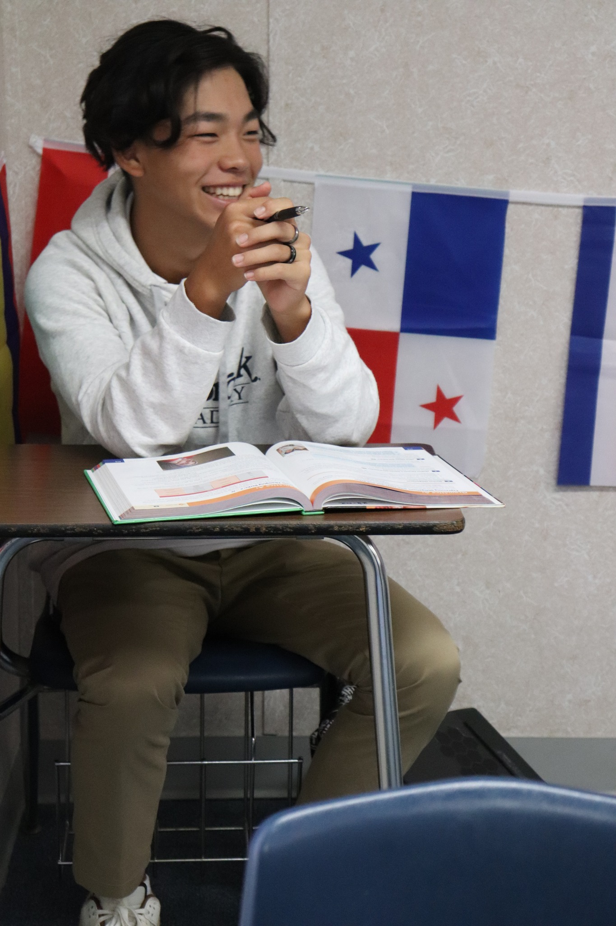
 | M | T | W | R | F | Weekends
Early Morning | Breakfast | 7:00-7:25 |  |  |  |  |  | Week 0
Wake-Up-7:25
Period 1 | Precalculus |  |  |  |  | @Inspiration L6 | Week 1
7:30-8:20
Period 2 | Spanish 3 |  |  |  |  | @SVB UTR | Week 2
8:25-9:15
Period 3 | Health |  |  |  |  | @Sekou's L6 | Week 3
9:20-10:10
Period 4 | Economics |  |  |  |  | @SVB UTR | Week 4
10:20-11:10
Period 5 | English 12 |  |  |  |  | Saddlebrook Splitz Blitz L5 | Week 5
11:15-12:05
Lunch | Lunch |  |  |  |  | @Inspiration UTR | Week 6
12:05-12:35/1:00
Period 6 |  |  |  |  |  |  | Week 7
12:40-1:30
Sport | Tennis | 1:00-3:00 Strength & Conditioning | 3:00-5:00 |  |  |  |  | @Hunter's Creek L6 | Week 8
1:00-5:00
Evening Free 1 |  |  |  |  |  | @SVB UTR | Week 9
5:00-700
Study Hall/Grocery/Free 2 | Study Hall |  |  | Grocery |  | @Inspiration UTR | Week 10
7:00-8:30
Evening Free 3 |  |  |  |  |  |  | Week 11
8:30-Lights Out
 |  |  |  |  |  |  | Week 12
 |  |  |  |  |  | Saddlebrook L6 | Week 13
 |  |  |  |  |  |  | Week 14
 |  |  |  |  |  | @Inspiration UTR | Week 15
 |  |  |  |  |  | @SVB UTR | Week 16
 |  |  |  |  |  |  | Week 17
 |  |  |  |  |  |  | Week 18
Sample High School Schedule

Slide 39
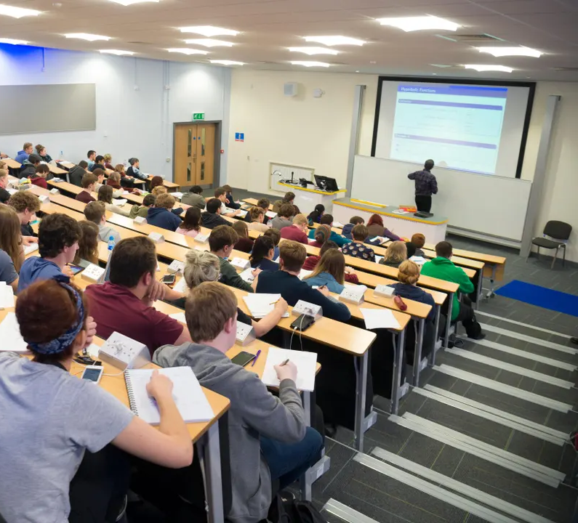
 | M | T | W | R | F | Weekends
Early Morning | Breakfast | 6:20-6:45 |  |  |  |  |  | Week 0
Wake-Up-7:25
Period 1 | Practice | 7:00-10:00 |  |  |  |  | Texas (Su@12) | Week 1
7:25-8:15
Period 2 | Practice | 7:00-10:00 |  |  |  |  | @UCF (Su@5) | Week 2
8:30-9:20
Period 3 |  |  |  |  |  | USF (F@2) Mississippi State (Sa@2) | Week 3
9:35-10:25
Period 4 | Clean-Up | 10:00-10:30 Lunch | 11:00-11:30 |  |  |  |  | FSU (R@5 in Lake Nona) USC (Sa@2 in Lake Nona) Stanford (Su@10 in Lake Nona) | Week 4
10:40-11:30
Period 5 | PHH 2015 | MAC 1140 | DISC | PHH 2015 | MAC 1140 | PHH 2015 | Kentucky (F@1 in Chicago) UNC (Sa@1 in Chicago) Baylor (Su@10 in Chicago) | Week 5
11:45-12:35
Period 6 | ECO 2013 | Library | ECO 2013 | MAC 1140 | ECO 2013 | @Mississippi State (R@4) @LSU (Sa@1) | Week 6
12:50-1:40
Period 7 | GLY 1000 |  | GLY 1000 | Library | GLY 1000 | Alabama (Su@12) TCU (T@5) | Week 7
1:55-2:45
Period 8 | Nap, Rest, Meditation | 3:00-3:30 |  |  |  |  | @Ole Miss (R@4) @Vandy (Sa@12) | Week 8
3:00-3:50
Period 9 |  |  |  | GLY 1150 | LAB |  | Arkansas (F@5) Auburn (Su@12) | Week 9
4:05-4:55
Period 10 | Strength and Conditioning | ~5:00-6:00 |  |  |  |  | @Texas A&M (Sa@2) | Week 10
5:10-6:00
Period 11 | Clean-Up | ~6:00-6:30 Dinner | 6:30-7:00 |  |  |  |  | Eastern Kentucky (W@10 and 2) Tennessee (F@5) Georgia (Su@12) | Week 11
6:15-7:05
E1 | ECO 2013 | SG | CLA 2100 | Stud. Org | 7:00-8:00 | CLA 2100 |  | UNF (T@5) Kentucky (F@5) @South Carolina (Su@1) | Week 12
7:20-8:10
E2 |  | CLA 2100 |  |  |  | SEC Tournament (W-Su in Auburn) | Week 13
8:20-9:10
E3 |  |  |  |  |  | NCAA Tournament Rounds 1 and 2 | Week 14
9:20-10:10
Late Night |  |  |  |  |  | NCAA Tournament Sweet 16 and Elite 8 | Week 15
After Class-Bed
Sample College Schedule

Slide 40
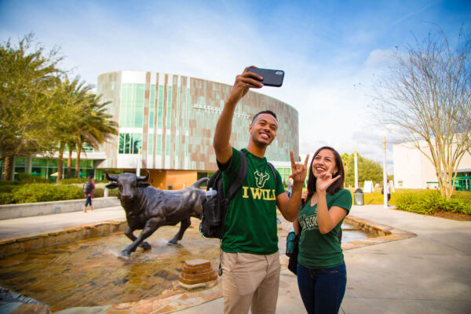
College Advising Activities
Résumé Writing Seminar
NCAA Initial Eligibility Center Discussion and Registration
USF Campus Visit
College-Bound Seniors Seminar

